Slide 1
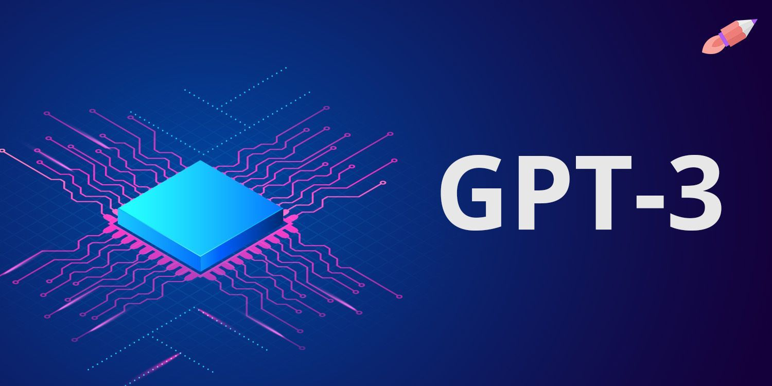
ARNOB RAHEE
18101225 | SEC-02
Arnob Rahee
ID-18101225
SEC-02

Slide 2
History
DEVELOPED BY
OpenAI research(June11 2020)
Co Founder:
Elon Musk
Notes:
This is the question that your experiment answers

Slide 3
Introduction
Genarative Pretained Transformer uses autoregressive to produce human like text
Trained on Azures AI supermodel
Trained on unlabelled datasets

Slide 4
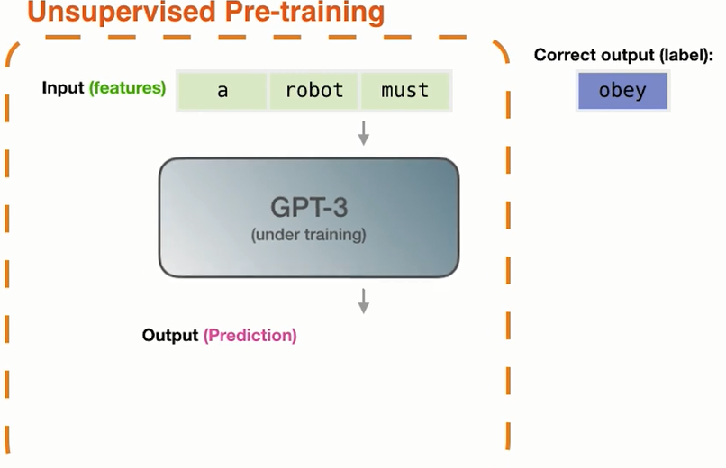

Slide 5
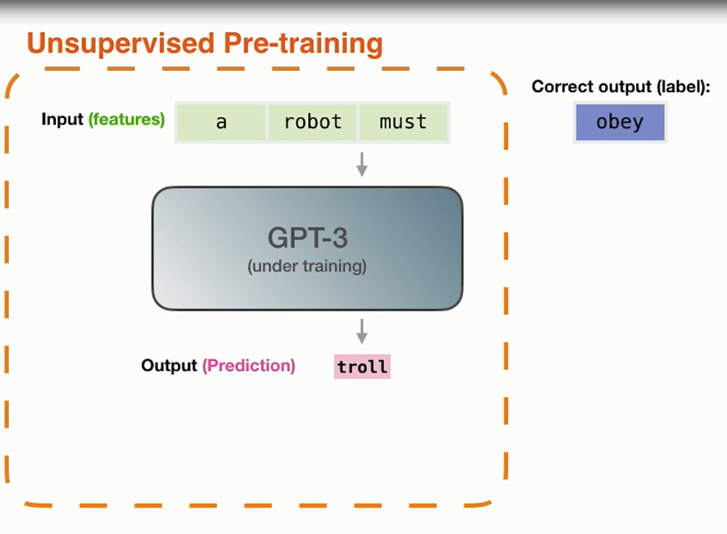

Slide 6
Architecture
Uses 175 billion parameters
Transformer-based neural network
Has 2048 tokens
Notes:
Summarize your research in three to five points.

Slide 7
Input: Recite first law of Robotics
Output:A Robot may not injure a human being
Transformer 1
Transformer 2
.
.
.
Transformer 96

Slide 8
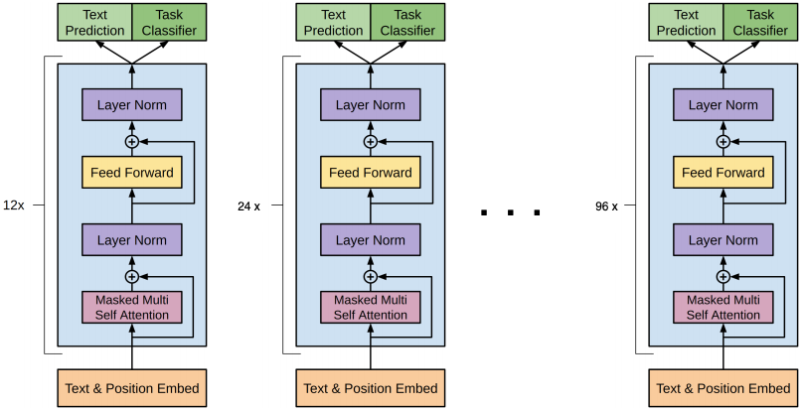

Slide 9
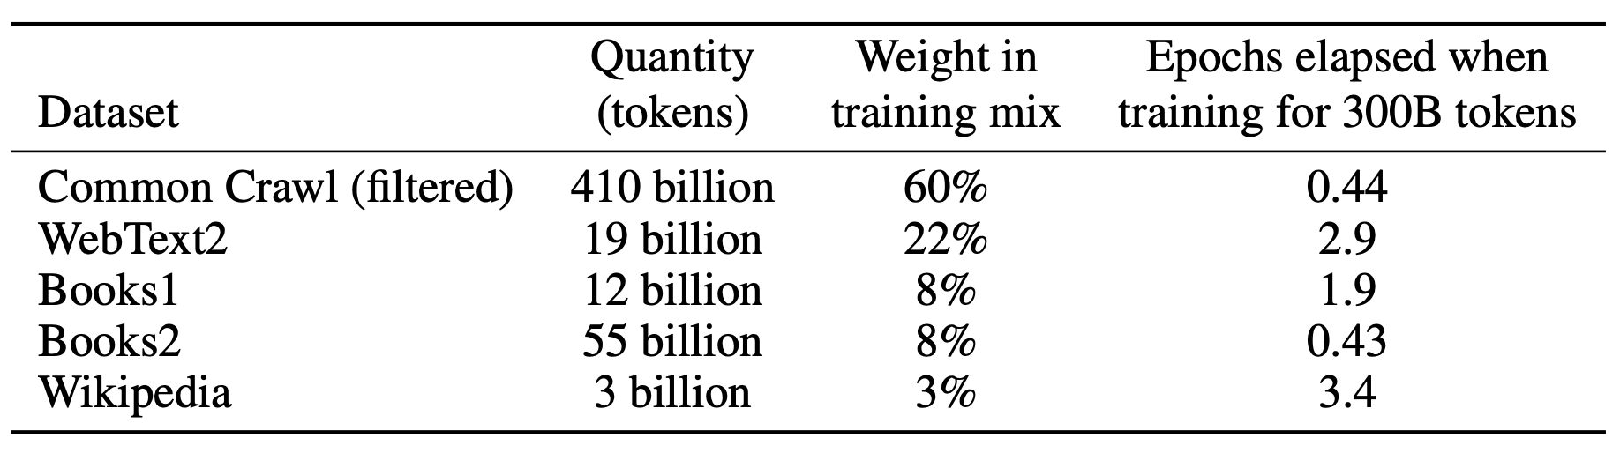

Slide 10
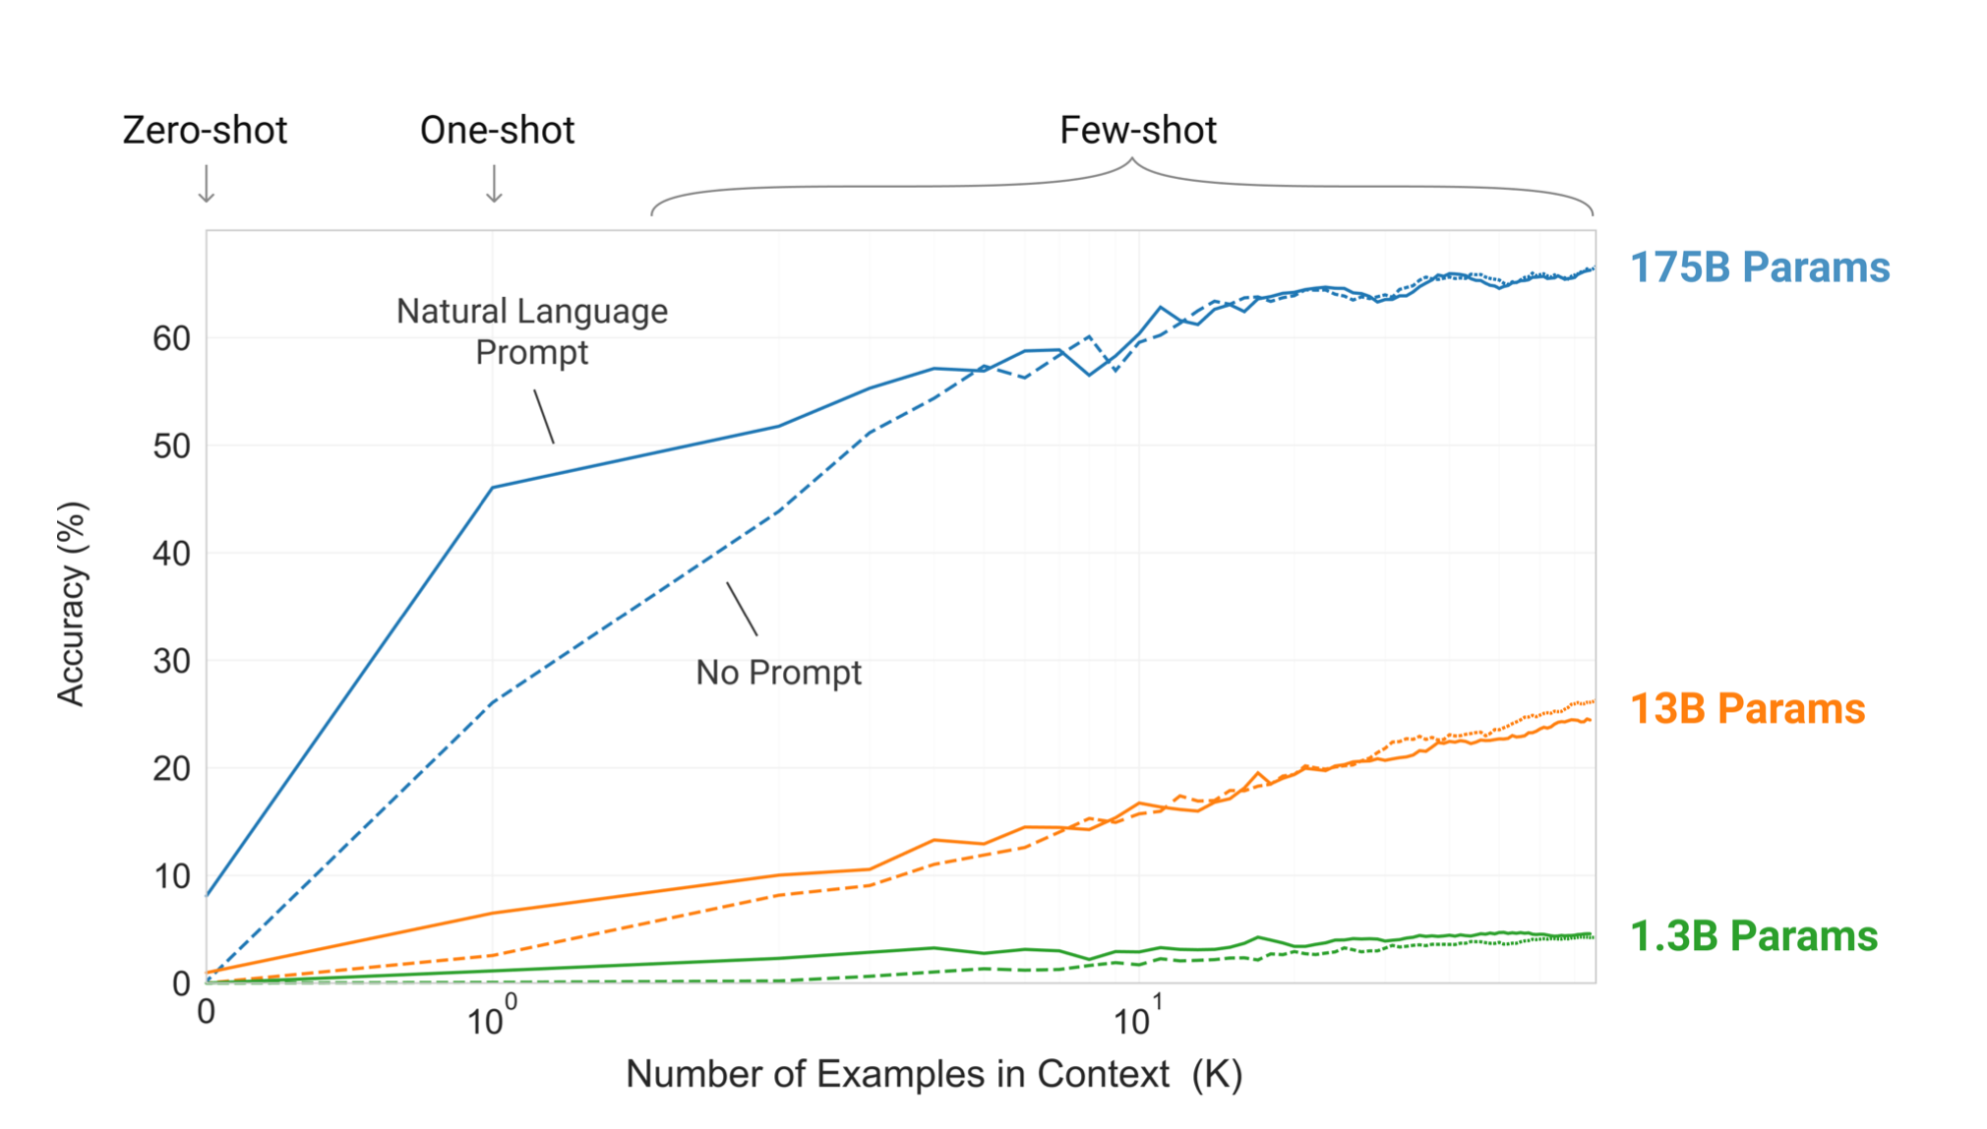

Slide 11
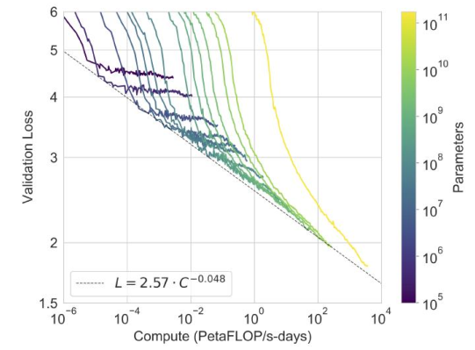

Slide 12
Application
AI for podcasts
Code generator
Entity extractor

Slide 13
Limitations
Lack semantic coherence
Gives biased information based upon data
Output could be assertive not in harmony with the truth
Fails on Turing test

Slide 14
GPT-3 vs BERT
BERT is bidirectional
Open source
Requires fine tuning unlike GPT-3

Slide 15
GPT-3 vs GAN
Generative adversarial networks (GANs) uses opposing neural networks
Used in image generation, voice generation and video generation
Eg Deepfakes

Slide 16
THANK YOU

